Slide 2
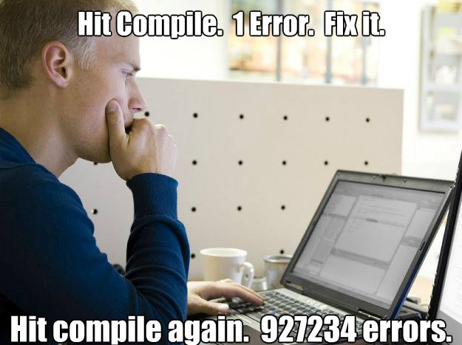
Using a Debugger
Because we’ve all been here:

Slide 3
Using a Debugger
Debugger: a program to execute your program and analyze its run-time behavior
A debugger lets you stop and restart your program, see contents of variables, and step through it
The larger your programs, the harder to debug them simply by inserting print commands
Debuggers can be part of your IDE (e.g. Eclipse, BlueJ) or separate programs (e.g. JSwat)
Three key concepts:
- Breakpoints
- Single-stepping
- Inspecting variables

Slide 4
public class Main {
/**
* @param args
*/
public static void main(String[] args) {
Counter counter = new Counter();
counter.count();
System.out.println("We have counted " + counter.getResult());
}
}
public class Counter {
private int result=0;
public int getResult() {
return result;
}
public void count() {
for (int i = 0; i < 100; i++) {
result += i +1;
}
}
}

Slide 5
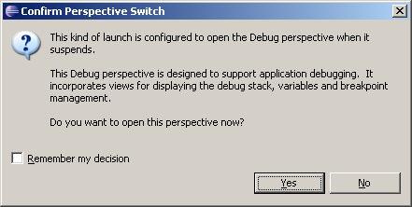
Put in toggle breakpoints:
- Right click in left column for the line you want the breakpoint on
or double click
- Run -> Toggle Breakpoint
To run the debugger:
Run -> Debug As -> Java Application
The first time you run the debugger:

Slide 6
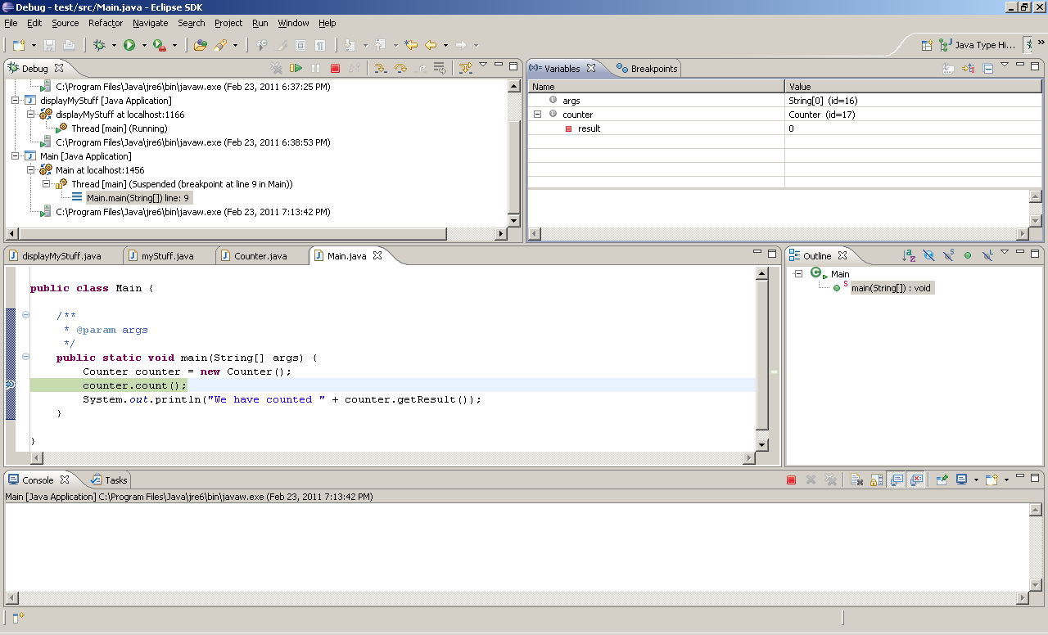
The Debugger Stopping at a Breakpoint
Now “step into” the count method
F5 – Step into

Slide 7
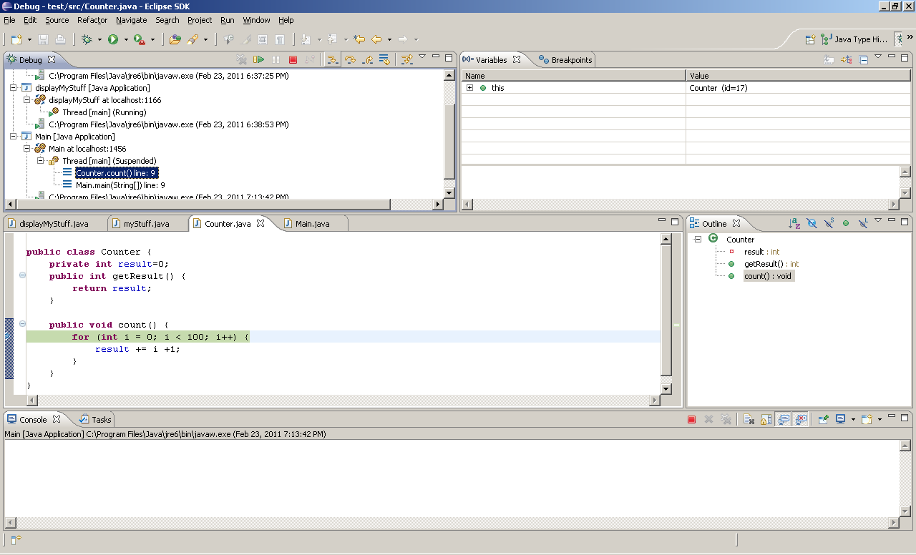
Now “return” (F7) to the calling method

Slide 8
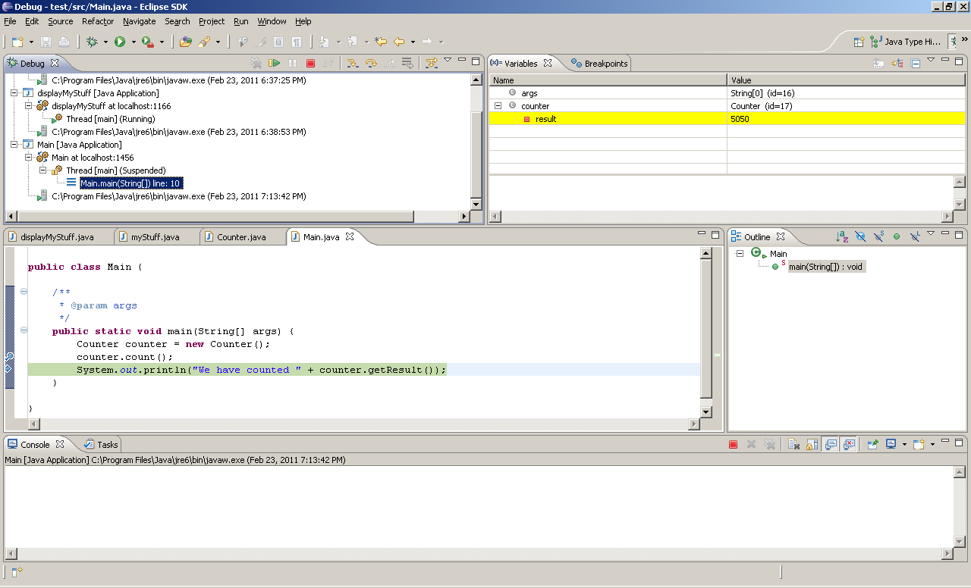
Inspecting Variables
Now “resume” (F8) to the calling method

Slide 9
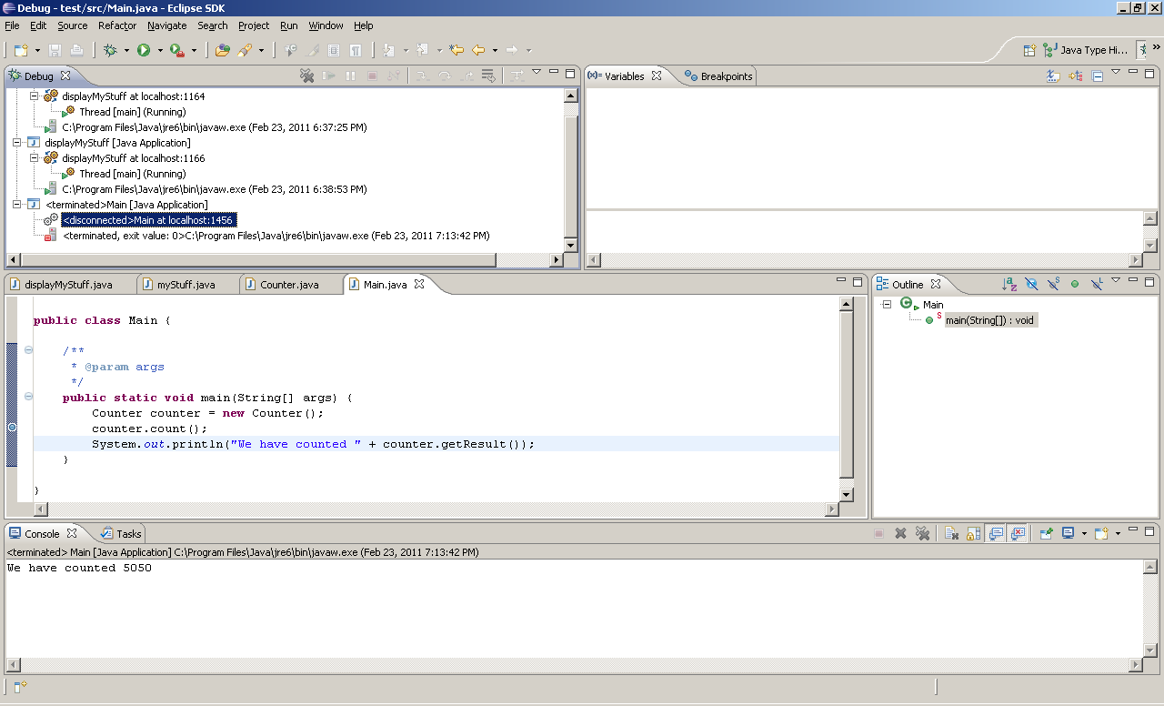

Slide 10
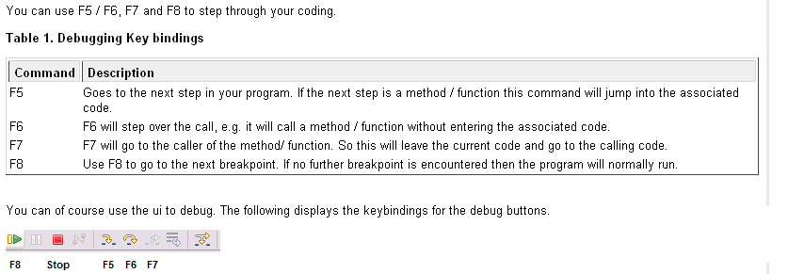
Step into
Step over

Slide 11
Debugging
- Execution is suspended whenever a breakpoint is reached
- In a debugger, a program runs at full speed until it reaches a breakpoint
- When execution stops you can:
- Inspect variables
- Step through the program a line at a time
- Or, continue running the program at full speed until it reaches the next breakpoint
- When program terminates, debugger stops as well
- Breakpoints stay active until you remove them
- Two variations of single-step command:
- Step Over: Skips method calls
- Step Into: Steps inside method calls

Slide 12
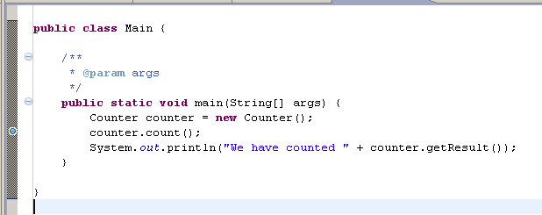
Single-step Example
When you step over method calls, you get to the next line:
System.out.println("We have counted " + counter.getResult());

Slide 13
Single-step Example (cont.)
However, if you step into method calls, you enter the first line of the count method:
public void count() {
for (int i = 0; i < 100; i++) {
result += i +1;
}
}

Slide 14
To get out of the debug perspective:
Window -> Open Perspective -> Java

Slide 15
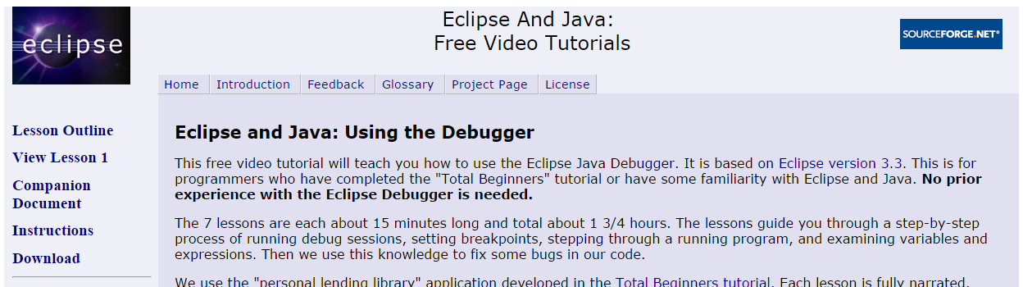
Other resources
http://eclipsetutorial.sourceforge.net/debugger.html

